Slide 1
Gate Recurrent Unit
Presented by: Javin, Yuxuan, Yintao, Andy
Notes:
Hello guys, since our group already talked about the LSTM last week, we will be focusing more on the GRU or Gate Recurrent Unitl.

Slide 2
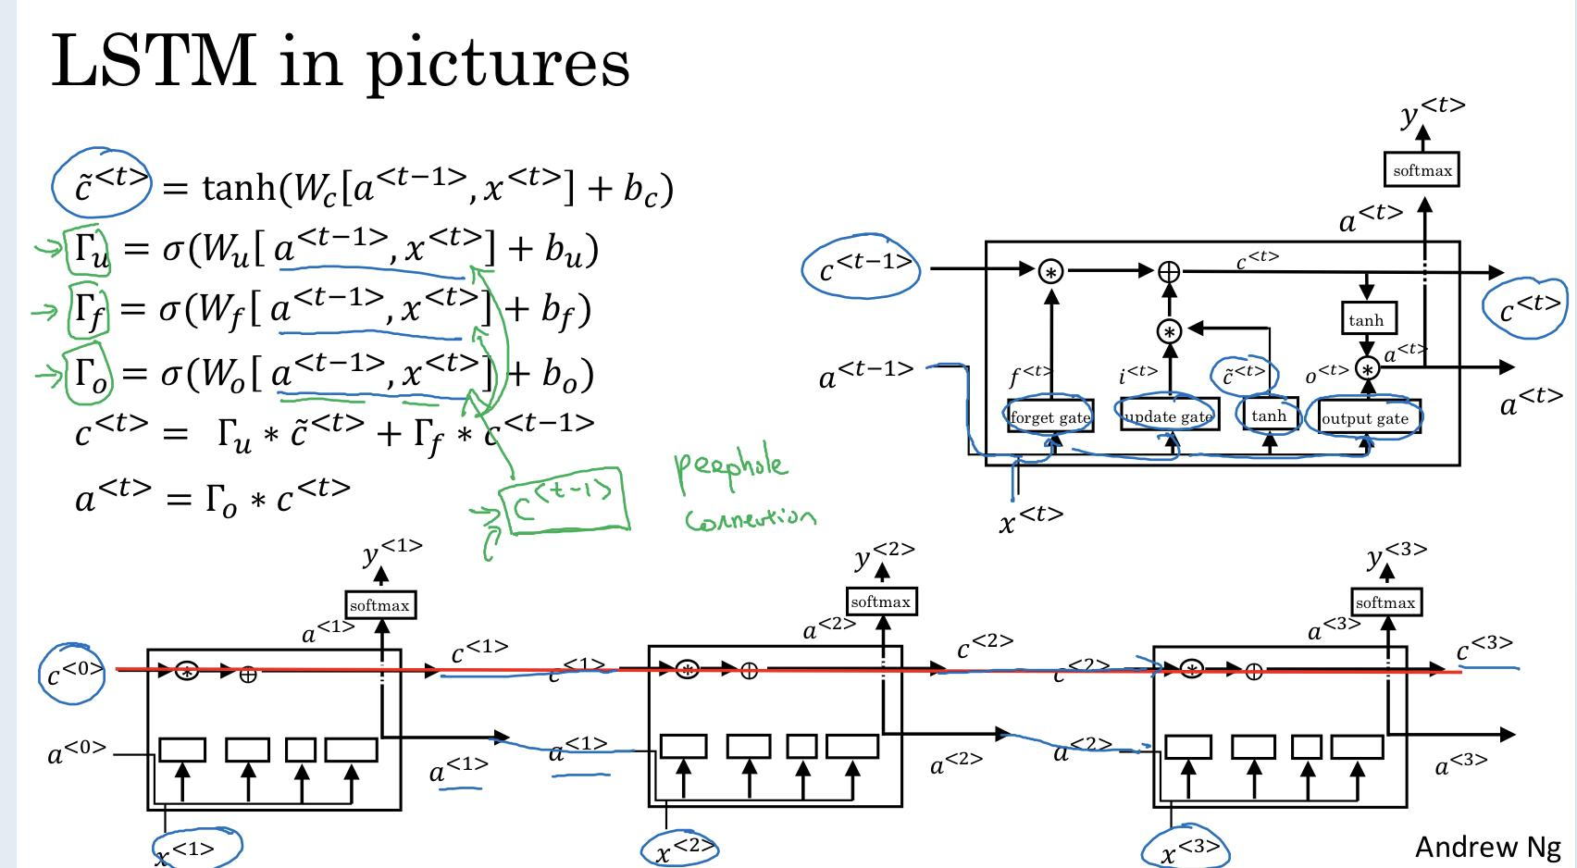
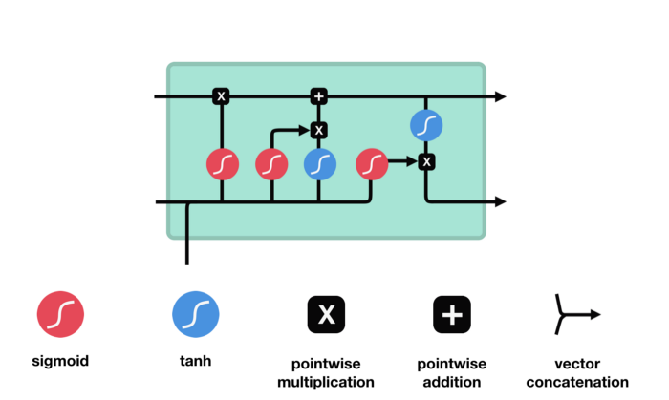
LSTM Explained (Skip because we already talked about it last week)
From Deeplearning.ai Course 5
Notes:
We already made a lstm using pytorch last week so this week we built an GRU and LSTM using Tensorflow. Since we talked about the LSTM last week already, we will quickly go over next few slides because of time restraints. (Javin)

Slide 3
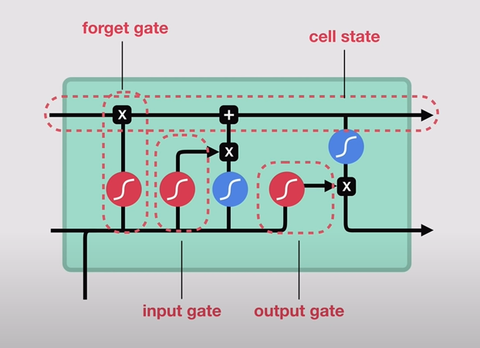
LSTM Components (Skip)
Notes:
The LSTM have 4 components that provides us with the short term feature. The gates are the forget gate, input gate, output gate. (Javin)

Slide 4
LSTM Step 1: Pass Info to the forget gate
(Skip because of time constraint)
Notes:
We take a output from the previous hidden state (ht-1) and then we take the input of our current state Xt and combine them to form a vector. We pass this into the forget gate (Javin)

Slide 5
LSTM Step 2: Pass info to the input gate
(Skip because of time constraint)
Notes:
We pass the same vector combination of the ht-1 and Xt to the input gate. (Javin)

Slide 6
LSTM Step 3: Calculate Candidate
(Skip because of time constraint)
Notes:
We calculate the candidate by adding together the forget gate output and the input gate output. This essentially serves as the input to the next sequence. (Javin)

Slide 7
LSTM Step 4: Pass into output Gate
(Skip because of time constraint)
Notes:
The same initial vector we passed to the other two gates is passed to the output gate which applies the tangent function to the initial vector and sigmoid to the candidate (which is the addition of the outputs from the input gate and forget gate). We then multiply the output of the two activation functions and the pass the hidden state out to the next section of the LSTM sequence.(Javin)

Slide 8
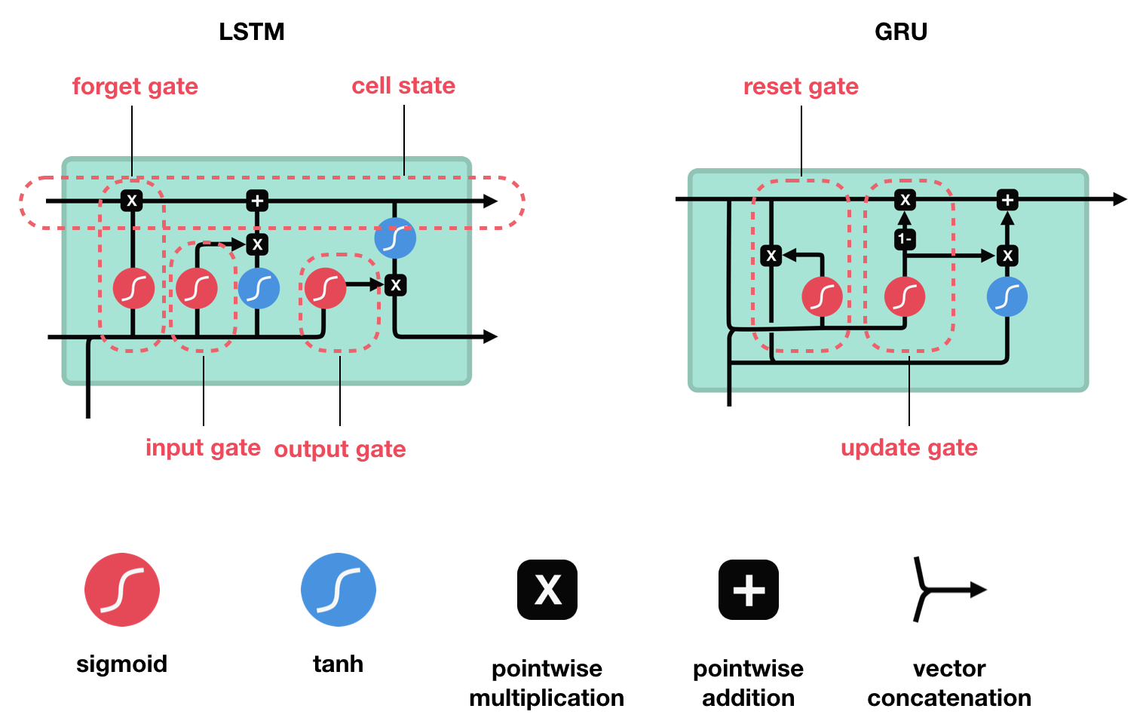
GRU VS LSTM Explained
Like the LSTM, GRU also attempts to improve on the basic RNN. Unlike the LSTM, GRUs don’t have the cell state and relies solely on the hidden state to pass info to the next sequence state. We have gates to control the flow of info.
Notes:
Like the LSTM, GRU also attempts to improve on the basic RNN. Unlike the LSTM, GRUs don’t have the cell state and relies solely on the hidden state to pass info into the next sequence state. We have gates to control the flow of info. (Javin)

Slide 9
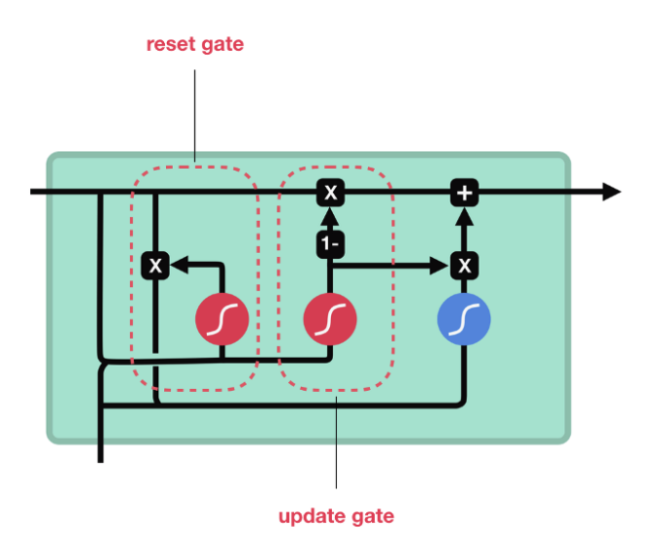
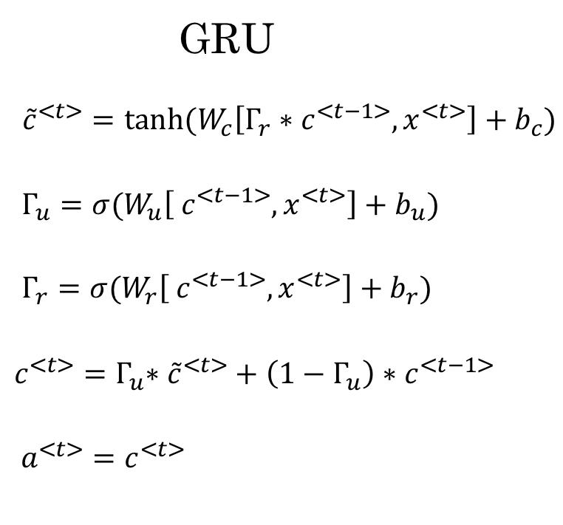
GRU Equations
The GRU consists of two gates, the reset gate and the update gate. The reset gate has a sigmoid function which helps regulate the data and decides which ones to keep or forget. The update gate updates the info and may add or remove info.
Notes:
The GRU consists of two gates, the reset gate and the update gate. The reset gate has a sigmoid function which helps regulate the data and decides which ones to keep or forget. The update gate updates the info and may add or remove info. We pass the info into the tanh function and get the C hat which is then multiplied by the out put of the update function and added to the 1-gamma value of the update gate multiplied by the c t-1. This is passed out as the hidden state which is useful for our predictions. (Javin)

Slide 10
Application & Dataset
Corona-tweets
IMDB
Sentiment Prediction
5 Classes:
extremely negative, negative, neutra, positive
extremely positive
Sentiment Prediction
2 Classes:
Negative, Positive
Fashion-MNIST
MNIST
Image Classification
10 Classes:
10 different clothes
Image Classification
10 Classes:
Handwritten digits 0-9
Notes:
LSTM and GRU structures can be be applied to many tasks. A very popular application is sentiment prediction. It is a classification task that takes texts as input, and sentiment, such as positive and negative as output. With LSTM and GRU structure, we can predict people’s feeling of the current COVID-19 situation or people’s attitude towards a movie. We also applied it to image classification tasks like MNIST and Fashion-MNIST. (Andy)

Slide 11
Model Structure
Notes:
With the basic knowledge of GRU and LSTM and our dataset, let’s dive deeper into the model structure for classification tasks. (Andy)

Slide 12
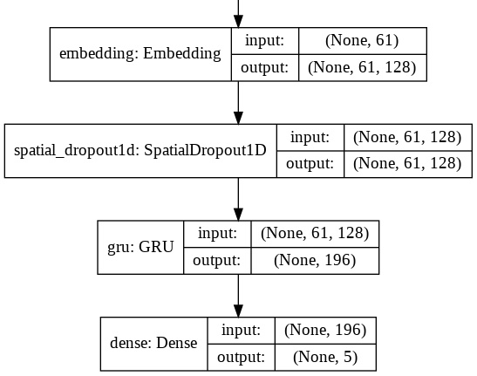
Model Structure
Notes:
Our model consists of four layers. First is the embedding layer. This layer encodes each word to a coordinate. Then we apply a dropout layer that takes out one feature in each epoch of training to reduce overfitting. Then, we feed in the input to the GRU or LSTM layer, and finally we apply a dense layer to reduce the dimension of the output of the GRU or LSTM layer. (Andy)

Slide 13


Word Embedding
Hi
Hello
Hi , how are you?
Hello , how are you?
Notes:
As we mentioned that the first layer of our model is an embedding layer, we would like to briefly introduce the concept of word embedding. The traditional way of training a classifier would be applying one-hot-encoding to every distinct word in the vocabulary and feed those giant sparse matrix into the RNN. Since all encoded vectors are orthogonal, it’s hard for the algorithm to detect words that are similar. In the example above, although “hello” and “hi” are similar in meanings, they have very different vector representation. Besides, large matrix multiplications can be computationally expensive.

Slide 14
Word Embedding
orange
apple
king
color
0.9
0.71
0.75
0.73
0.11
0.05
shape
Gender
0.00
0.21
0.00
0.30
0.99
0.85
Weight
Notes:
Instead, we would like to represent words with short vectors, and words of similar types or meanings should also have closer spatial representations. This is called word embedding

Slide 15
Word Embedding
orange
apple
king
Notes:
We see that the vectors of orange and apple are closer together

Slide 16
Word Embedding
apple
(one-hot encoded)
Embedding
Matrix
0
1
0
0
0
.
.
.
apple
(vector)
Trained
*
=
W
(4, 10)
x
(10, 1)
=
z
(4, 1)
*
Notes:
Let’s look at an example. assume that we have a (10, 1) one-hot-encoded matrix of “apple”, denoted as x, and we want to represent “apple” with a 4 dimensional vector. What we do is to train a (4, 10) randomly generated matrix, named embedding matrix, and multiplies it with the one-hot encoded vector. The composition produces a new (4,1) vector, which is what we want. Since the one hot encoded matrix has only 1 non-zero entry, depending on the position of this entry, second, in this example, the result vector will be identical to the second column of the embedding Matrix “W”. The structure of Word embedding is really similar to a dense layer, and the embedding Matrix learns during backpropagation, just like any other weight matrices.

Slide 17
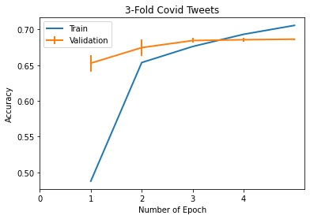
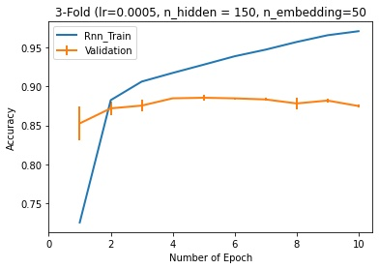
Performance Analysis
 | LSTM | GRU
Corona-tweets | 70.54% | 72.91%
IMDB | 87.14% | 86.98%
Fashion-MNIST | 88.58% | 86.37%
MNIST | 97.98% | 97.83%
Notes:
We ran our models on multiple real life datasets. We can see our models performs better on binary classification tasks than on multi-class classifications. That might due to the complexity of multi-class task. Also, we find the GRU has the similar performance with LSTM on these tasks.
got an accuracy of 97% on the mnist dataset, 77.63 percent, and 77.63 on the fashion MNIST dataset.

Slide 18
Problems of the Recurrency
Long-range dependance
Loss information through long distance
LSTM/GRU only mitigate, not solve this problem
Sequential nature
Backpropagation through time
Inhibits the parallel computation
Notes:
Although LSTM and GRU are amazing, two problems still remain. The forget gate decides when to forget the information, but once forgot, it can never remember again. But some information has a long-range dependency and it's impossible to know when we will need it again. Another problem is due to the recurrence, we can not run the RNN structure in parallel. We did some search and find a new structure that could solve these two problems.

Slide 19
Future Work
Self-Attention Networks: Transformers
Attention mechanism
Able to look preceding states in arbitrary distance
Parallel rather than sequential architecture
“Attention is All you Need”
Notes:
It’s could Transformer. Rather than recurrent structure, it uses a self-attention mechanism. This mechanism could enable the output unit to look back at previous inputs with arbitrary distance, solve the long-range distance problem.

Slide 20
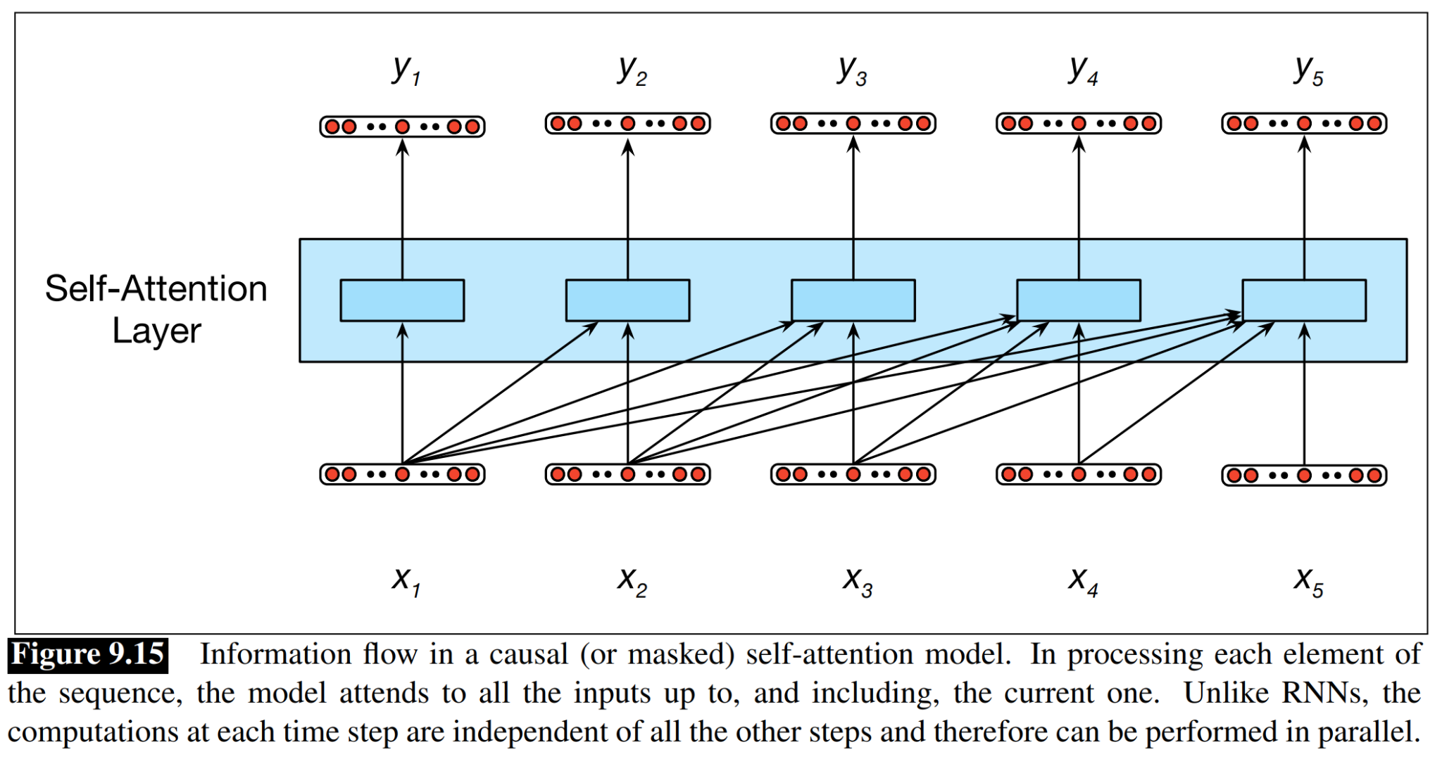
Self-Attention Layer
Attention mechanism
Like RNN, mapping sequence input x to sequence output y
Each y can access any preceding input x, whatever the distance
Notes:
To be short, the self-attention will calculate attention scores for each previous input, and the output unit uses the attention score to decide which previous input to look at. So it’s possible to look at any previous input with any distance. Also, the structure is parallel, speed up the calculation on parallel computers.

Slide 21
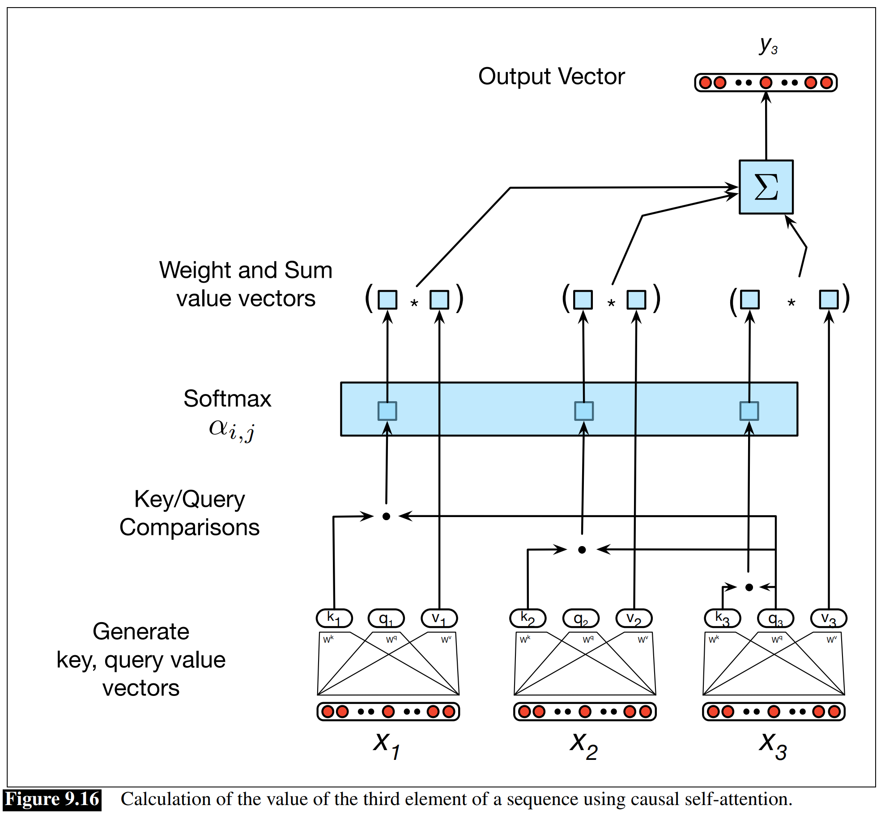
Information Retrieval
Query: being compared to all preceding inputs (current focus)
Key: preceding inputs be compared with the query
Value: the value passed to the output layer
How to calculate the attention score?
Dot product of the query and key
The attention score decide how much value to pass to the output
Notes:
This is the information retrieval structure, we don't have time to talk in detail. But we found a very understandable and comprehensive introduction in the Stanford NLP book. I very recommend it if you are interested.

Slide 22
Thanks
Do you have any questions?
Notes:
OK! Thank you for your attention. That’s all for today’s presentation. Do you have any questions?

Slide 23
References:
“What Is the Difference between an Embedding Layer and a Dense Layer?” Stack Overflow, 1 June 1966, stackoverflow.com/questions/47868265/what-is-the-difference-between-an-embedding-layer-and-a-dense-layer.
Google Colaboratory, Google, colab.research.google.com/github/CSCfi/machine-learning-scripts/blob/master/notebooks/keras-test-setup.ipynb#scrollTo=eOysW8iqBIJl wizardforcel.gitbooks.io/keras-tutorials-tgjeon/content/07_lstm.html.
Miglani, Aman. “Coronavirus Tweets NLP - Text Classification.” Kaggle, 8 Sept. 2020, www.kaggle.com/datatattle/covid-19-nlp-text-classification?select=Corona_NLP_test.csv.
“Using a Keras Long Short-Term Memory (LSTM) Model to Predict Stock Prices.” KDnuggets, www.kdnuggets.com/2018/11/keras-long-short-term-memory-lstm-model-predict-stock-prices.html.
Phi, Michael. “Illustrated Guide to LSTM's and GRU's: A Step by Step Explanation.” Medium, Towards Data Science, 28 June 2020, towardsdatascience.com/illustrated-guide-to-lstms-and-gru-s-a-step-by-step-explanation-44e9eb85bf21.
Dan Jurafsky and James H. Martin, Speech and Language Processing (3rd ed. draft), chapter 9
web.stanford.edu/~jurafsky/slp3/9.pdf

Slide 24
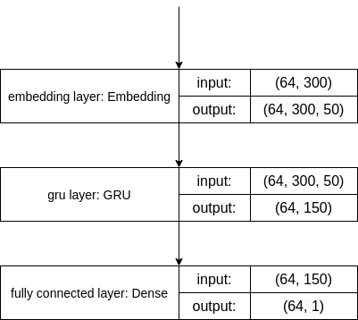
Embedding layer
Notes:
For reading text, we had to add a embedding layer before the LSTM to make it work. We found it very interesting and we would now like to tell you about how cool it is. ## Ethan or yintao insert explanation here

